Slide 1

Fitbit vs. Apple Watch
By Olivia Phillips

Slide 2
Does an Apple Watch track fewer steps than a Fitbit does?
How I tracked the data:
Wore both watches every day for 2 weeks to track my fitness data.
Alternated which watch was worn on each wrist every day.
If I needed to take one watch off for any reason, I took the other watch off too.
Charged both watches for two hours each night.

Slide 3
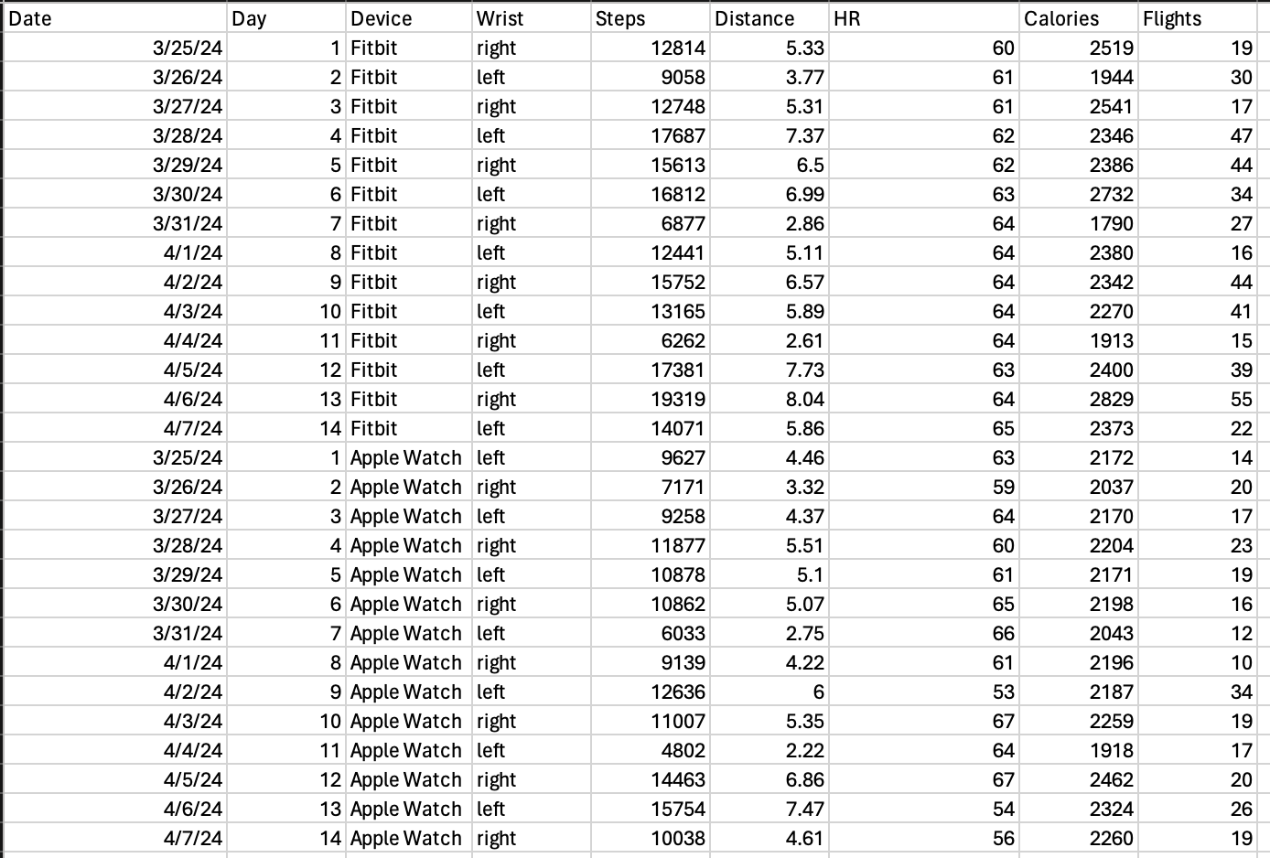
Data
Variables recorded:
Steps: total number of steps tracked for a given day.
Distance: total distance walked in miles for a given day.
HR: average resting heart rate for a given day.
Calories: total calories burned for a given day.
Flights: total flights of stairs climbed for a given day.

Slide 4
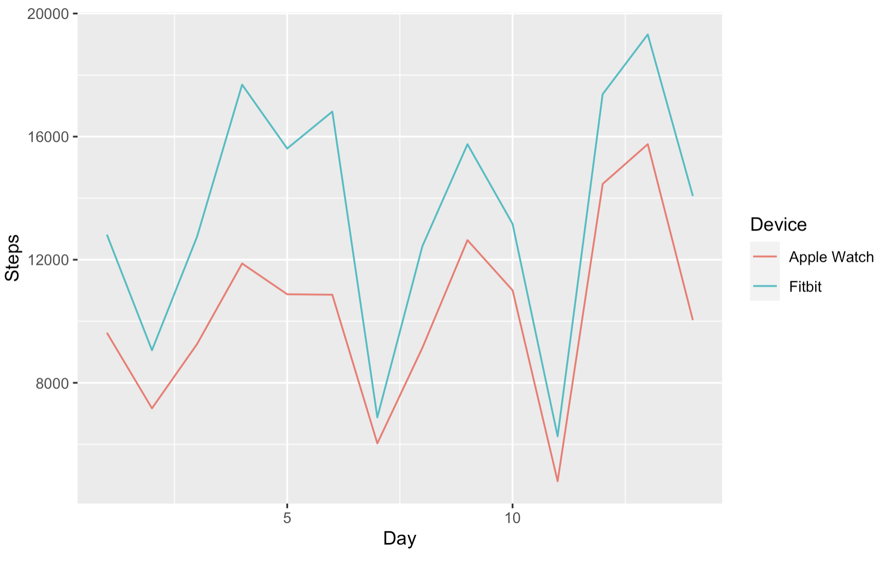
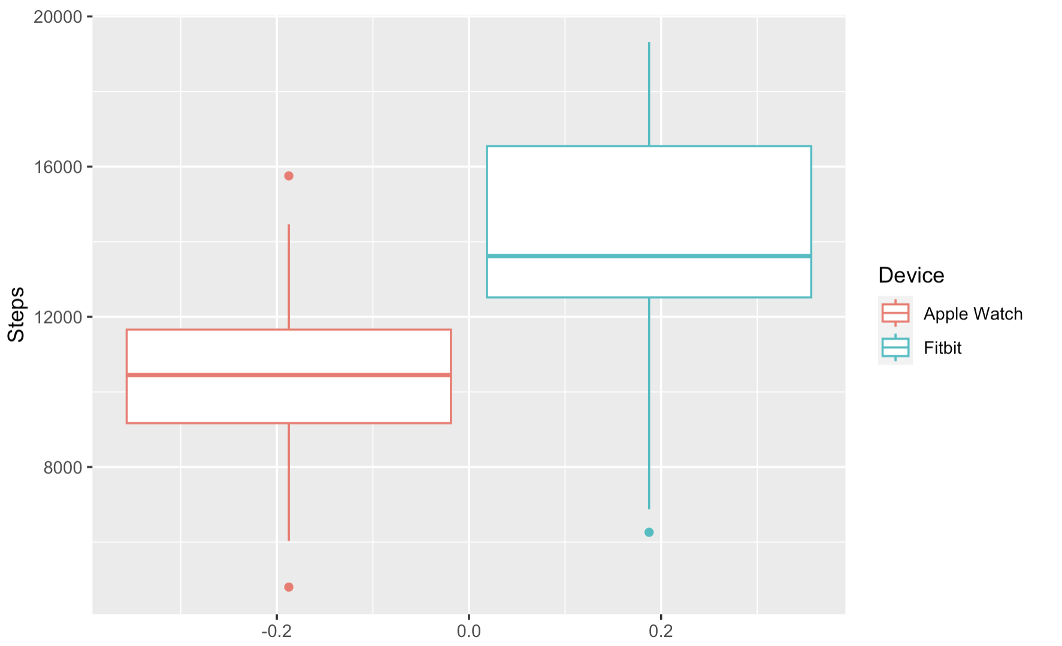
Visualization:

Slide 5
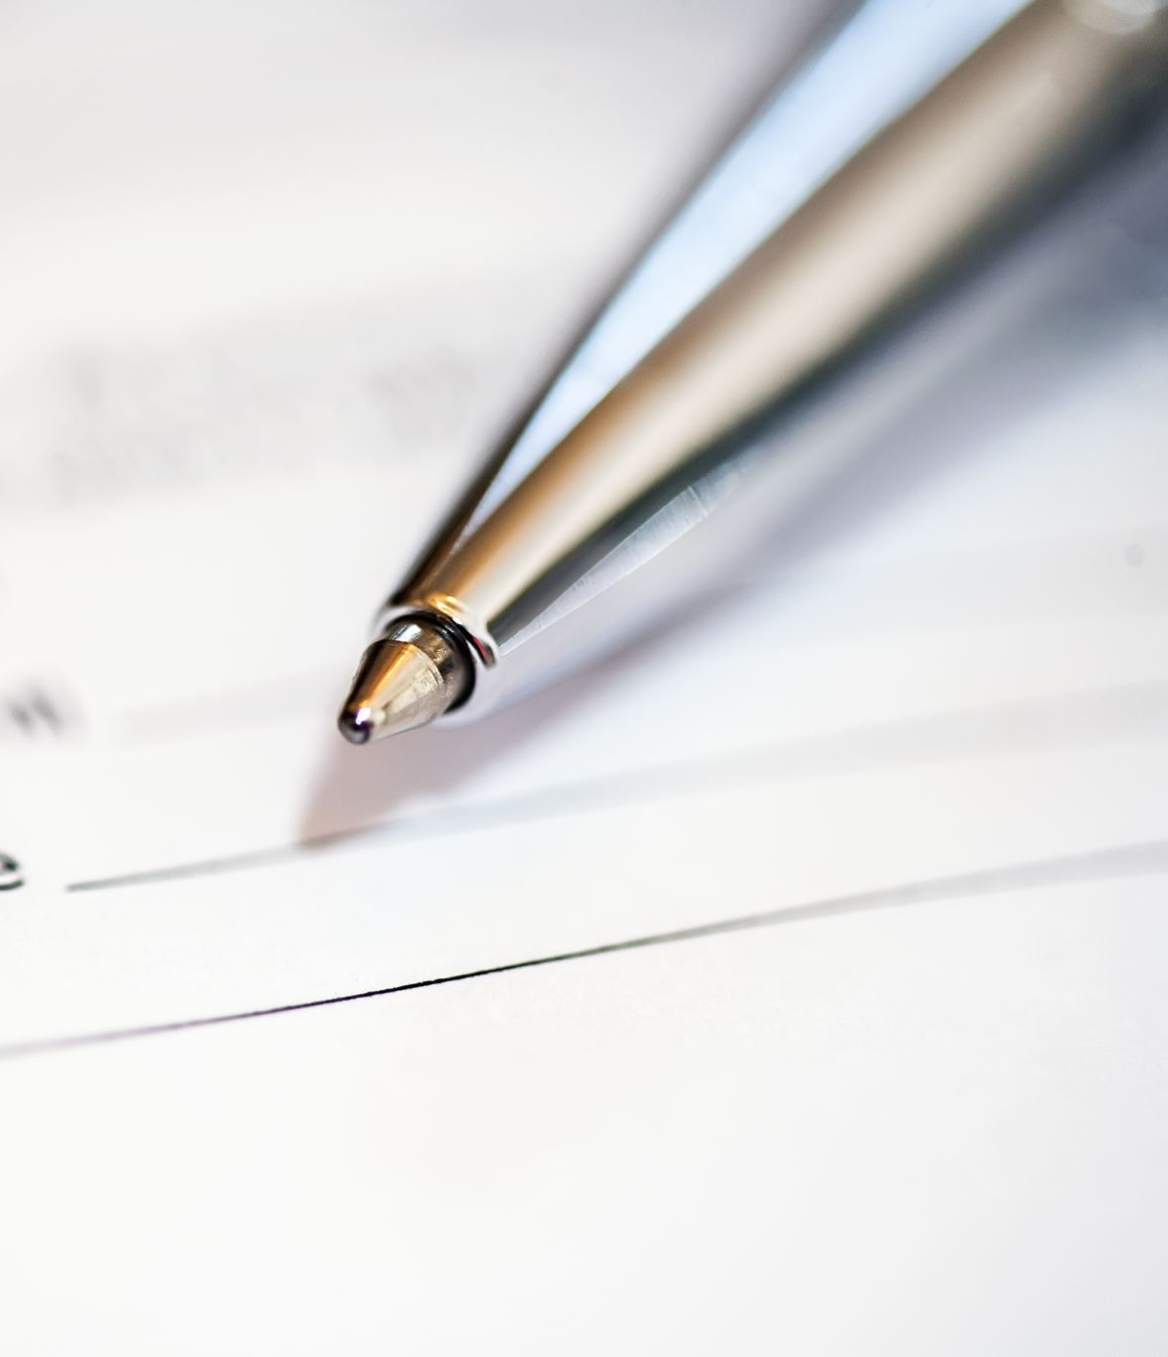

Claim and Hypotheses
Claim: The mean number of steps an Apple Watch SE tracks per day is less than the average number of steps a Fitbit Sense tracks per day.
$$H_{0}:μ_{A}−μ_{F}=0$$
$$H_{a}:μ_{A}−μ_{F}<0$$
$μ_{A}$: The mean number of steps an Apple Watch SE tracks per day.
$μ_{F}$: The mean number of steps a Fitbit Sense tracks per day.
A paired t-test with a significance level of 5% was used to test this claim.

Slide 6
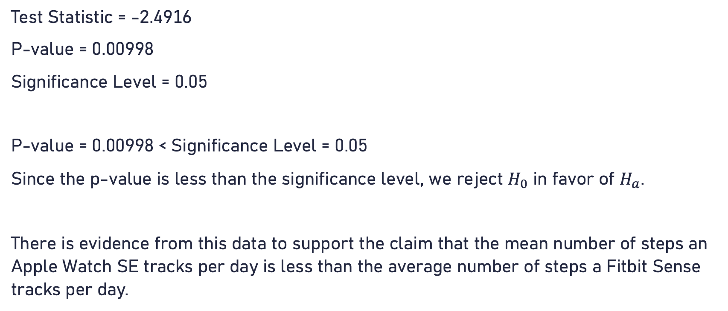
Conclusion
Test Statistic = -2.4916
P-value = 0.00998
Significance Level = 0.05
P-value = 0.00998 < Significance Level = 0.05
Since the p-value is less than the significance level, we reject $H_{0}$ in favor of $H_{a}$.
There is evidence from this data to support the claim that the mean number of steps an Apple Watch SE tracks per day is less than the average number of steps a Fitbit Sense tracks per day.

Slide 7
Summary Statistics for Steps
Device | Mean | Standard Deviation
Apple Watch | 10,253.21 | 3004.11
Fitbit | 13571.43 | 3975.58

Slide 8
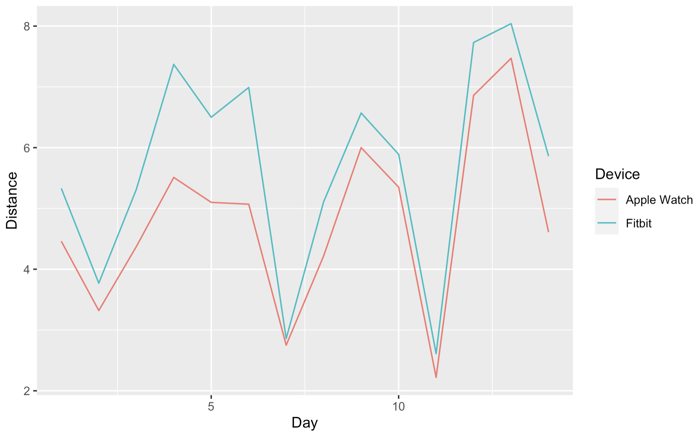
Summary Statistics for Distance
Device | Mean | Standard Deviation
Apple Watch | 4.807857 | 1.454527
Fitbit | 5.710000 | 1.698017

Slide 9
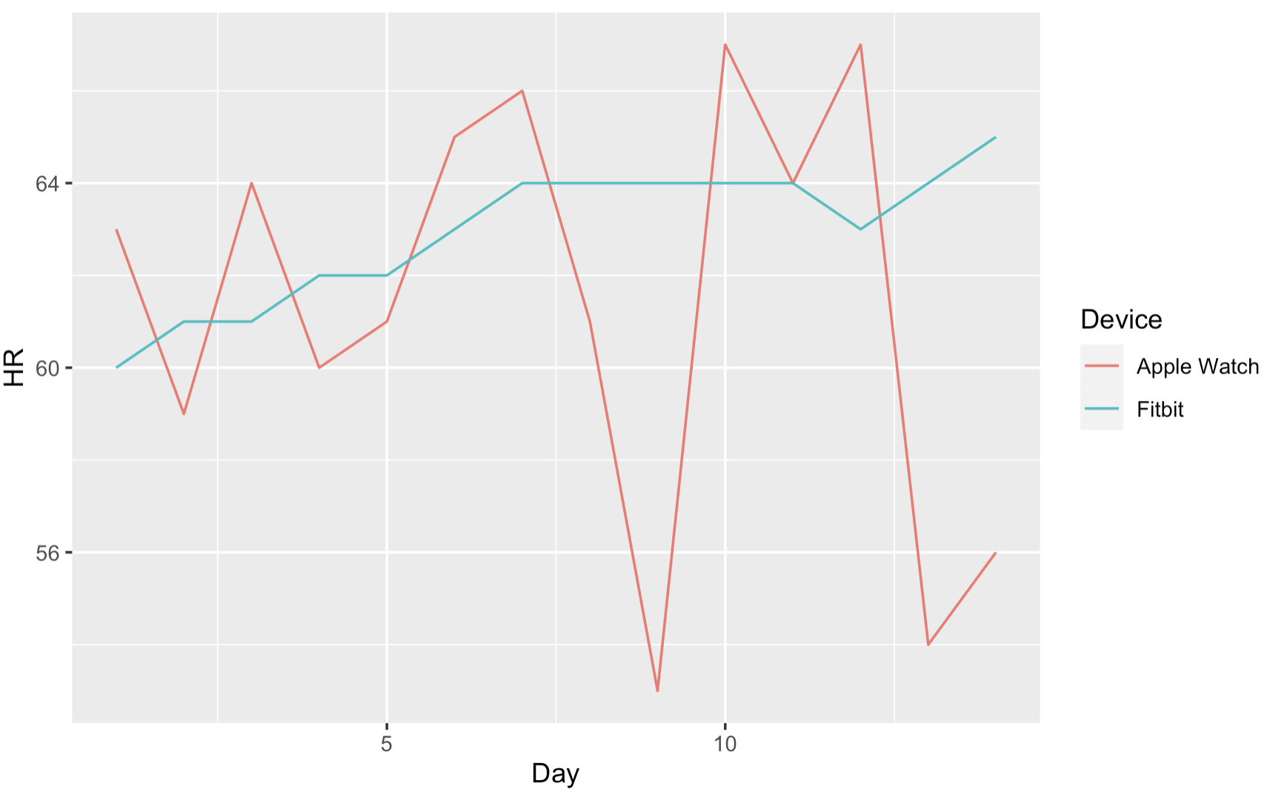
Summary Statistics for Heart Rate
Device | Mean | Standard Deviation
Apple Watch | 61.42857 | 4.602914
Fitbit | 62.92857 | 1.491735

Slide 10
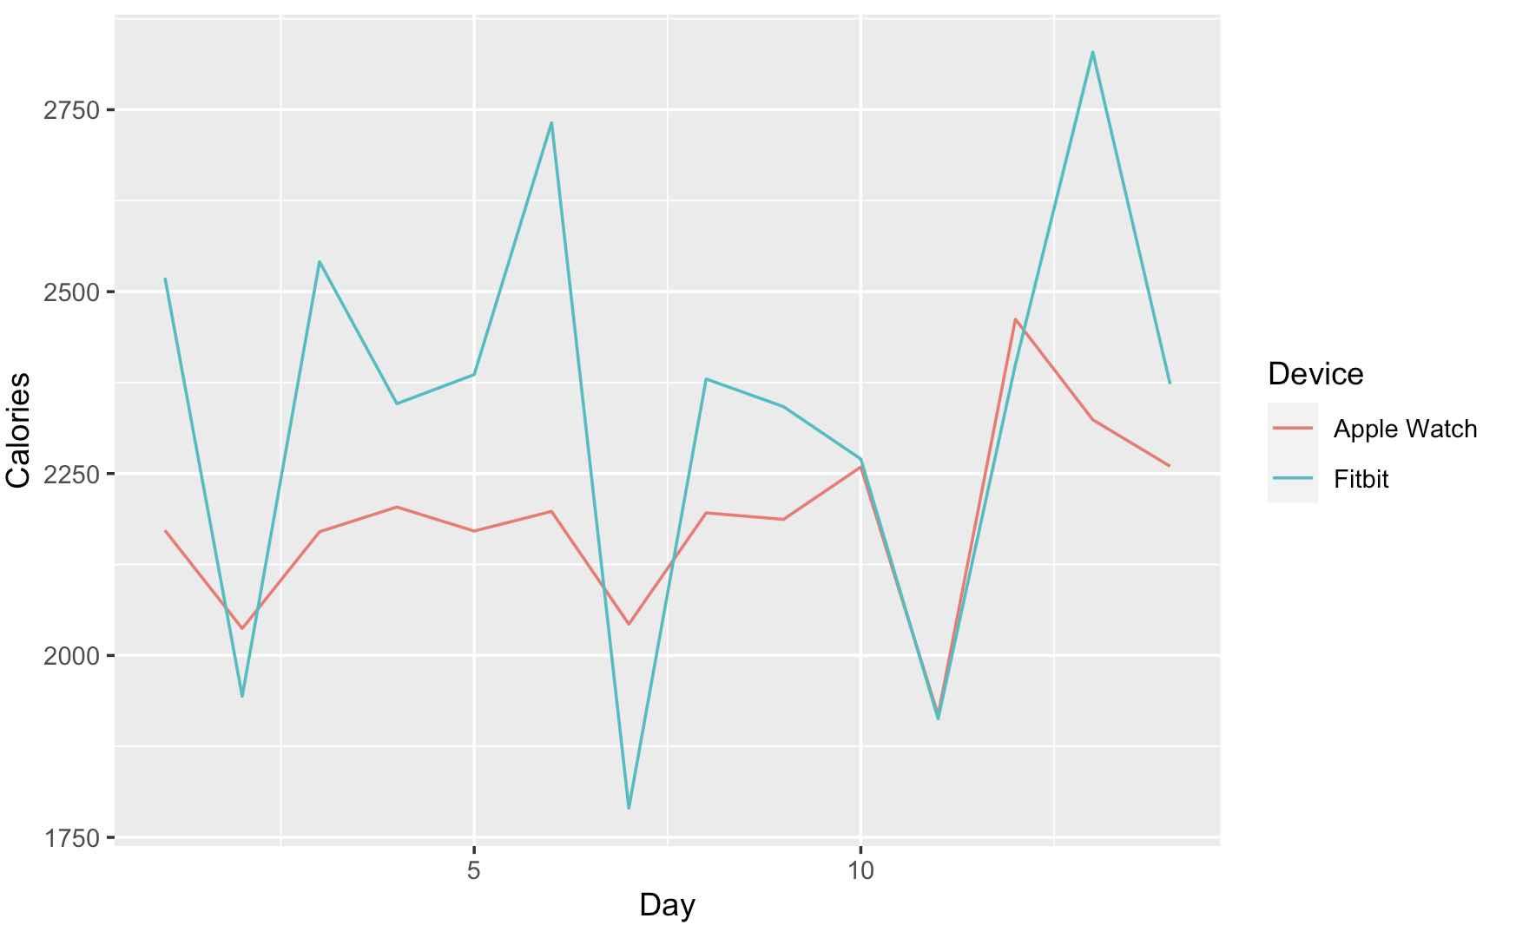
Summary Statistics for Calories
Device | Mean | Standard Deviation
Apple Watch | 2185.786 | 130.6034
Fitbit | 2340.357 | 293.5480

Slide 11
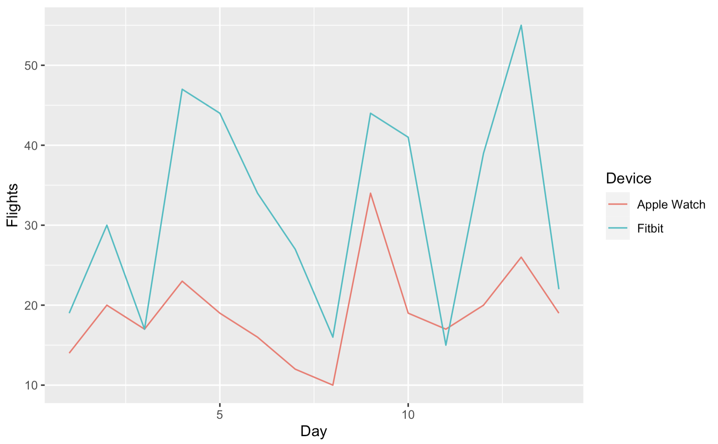
Summary Statistics for Flights
Device | Mean | Standard Deviation
Apple Watch | 19.00000 | 5.974304
Fitbit | 32.14286 | 13.137481

